Slide 1




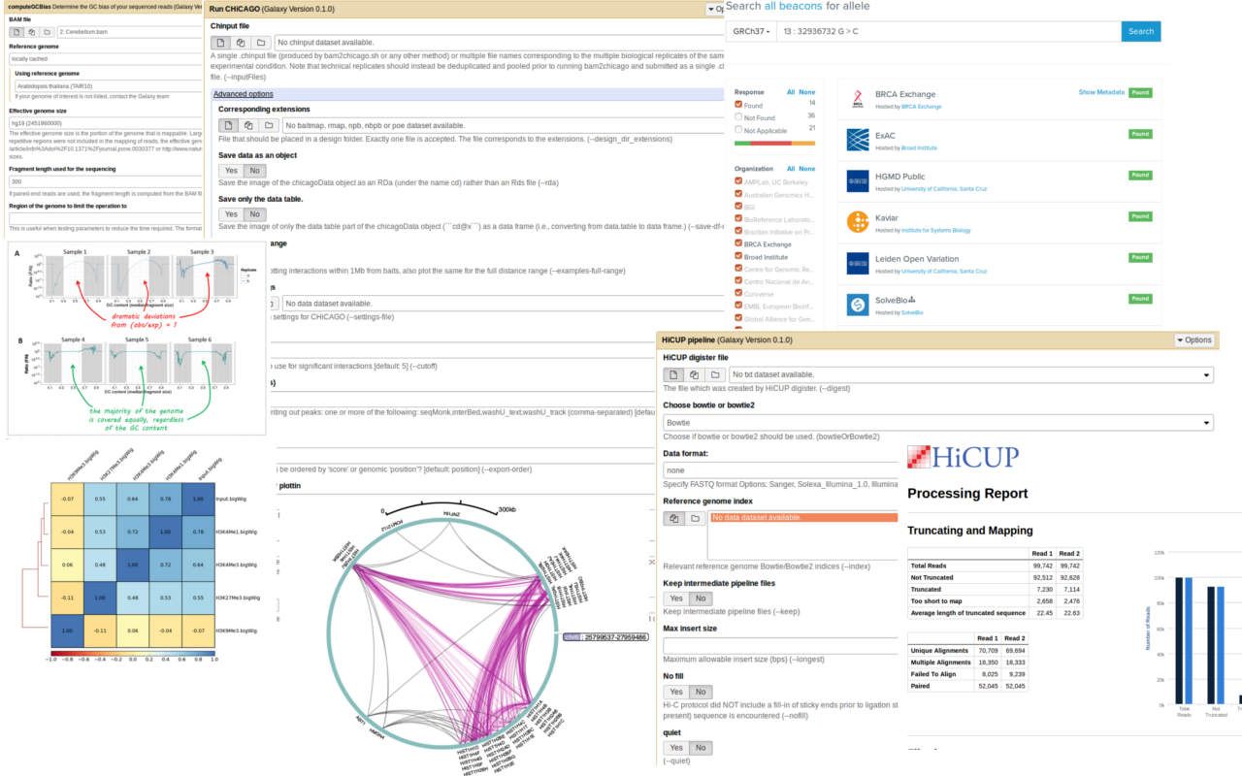
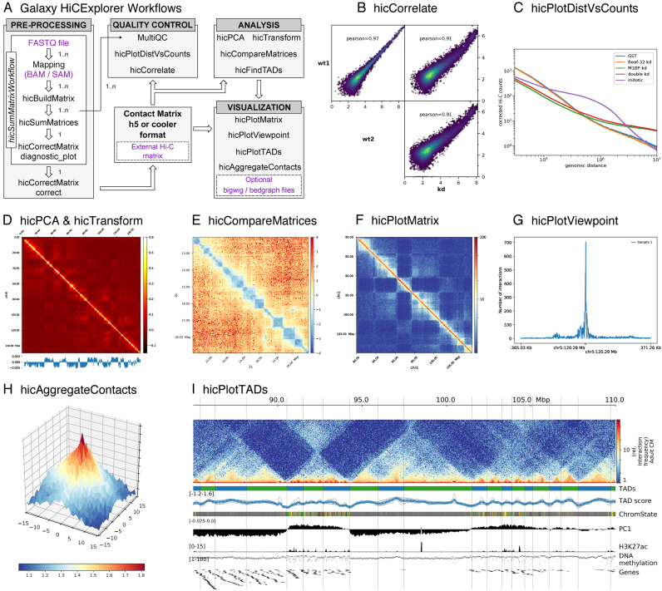



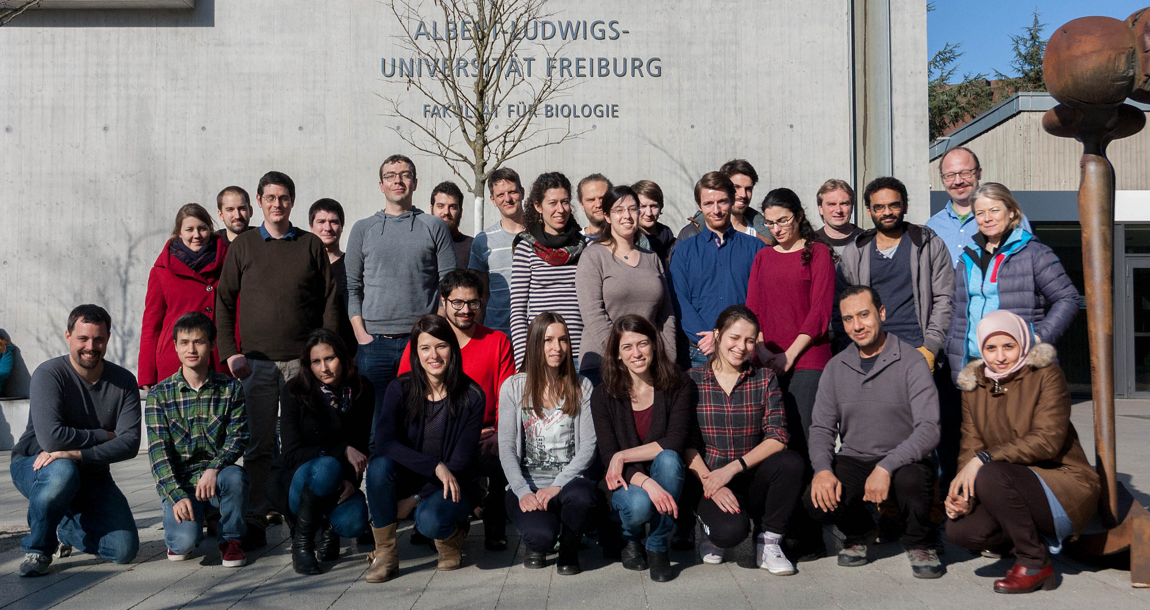
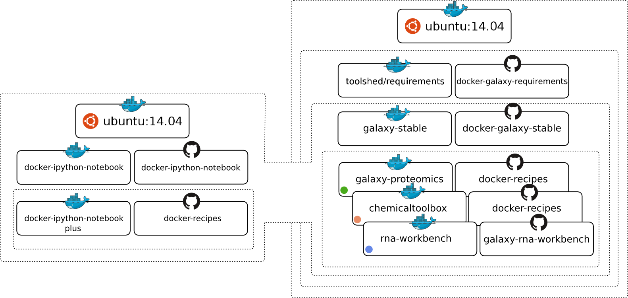


de.NBI-epi
RNA Bioinformatics Center
University of Freiburg
Chair of Bioinformatics
Fkz 031L0101C
Björn Grüning, Joachim Wolff
University of Freiburg, Germany
Description of de.NBI-epi
de.NBI services
The de.NBI-epi project in Freiburg offers:
Visualization, normalization and quality assessment:
Hi-C data analysis
MethylC-Seq data analysis
ChIP-Seq
Bisulfite sequencing analysis pipelines
Training and user support:
Galaxy HTS data analysis workshops
Self learning material on training.galaxyproject.org
Direct user support via gitter, GitHub or guest researcher
Available on:
All in one Gateway: https://usegalaxy.eu
Your computer with virtualized and personalized instances
Maintenance, development and integration of software into Galaxy to provide easy access for epigenetic analysis software:
deepTools
Bismark
HiCUP
CHiCAGO
Methyldackel
Methtools
HiCExplorer
Galaxy
Container: Docker, rkt, Singularity
Progress report
General information on the project
Development and maintenance of software for Hi-C data analysis.
HiCExplorer:
Improved training material: hicexplorer.readthedocs.io
TADs
A/B compartments
Loop detection
cHi-C support
HiCMatrix:
New modular structure
Faster I/O support
format support: Cool, hic,
homer, HicPro, h5
pyGenomeTracks:
New modular structure
Visualization of
Hi-C, ChIP-Seq
Bed, Bigwig tracks
Galaxy HiCExplorer:
Webserver to make HiCExplorer accessible over the web
https://hicexplorer.usegalaxy.eu
As part of the de.NBI-epi project in Freiburg, Joachim Wolff and Björn Grüning, are working closely with the RBC, de.NBI and ELIXIR to deliver high-class services for epigenetic research.
de.NBI services
Community based infrastructure
Bioconda is a conda channel which provides software for biomedical research.
20,151 commits on GitHub
575 contributors
> 4,400 packages
BioContainers provides system-agnostic executable environments for bioinformatics software.
Based on Docker & rkt
> 2,900 Images
Automatic builds from Bioconda
Galaxy is an open, web-based platform for data intensive research.
37,700 commits
196 contributors
One of the biggest Galaxy instances available for de.NBI in Freiburg
de.NBI training and education
The Galaxy Docker Project
The Galaxy Docker Image is an easy distributable full-fledged Galaxy installation, that can be used for testing, teaching and presenting new tools and features.
Portable data analysis in a box!
Hands-on training material for self-study available on training.galaxyproject.org
Introduction to HTS
RNA-Seq
ChIP-Seq
Hi-C
...and many more!
Based on the main Galaxy Docker virtualisation, a dedicated flavor for epi-
genetics was developed: github.com/bgruening/docker-galaxy-epigenetic
2018 past events
26.02 – 02.03.2018 | Galaxy Training Course | Freiburg
12.03. – 14.03.2018 | Medical Epigenetics Symposium | Freiburg
15.03. – 16.03.2018 | Galaxy user conference | Freiburg
24.06. – 02.07.2018 | Galaxy community conference | Portland, USA
17.09. – 21.09.2018 | Galaxy Training Course | Freiburg
24.09. – 25.09.2018 | Cardiovascular epigenetics conference | Freiburg
Publications
High-resolution TADs reveal DNA sequences underlying genome organization in flies.
doi: 10.1101/115063
The RNA workbench: best practices for RNA and high-throughput sequencing bioinformatics in Galaxy
doi: 10.1093/nar/gkx409
BioContainers: an open-source and community-driven framework for software standardization
doi: 10.1093/bioinformatics/btx192
Galaxy HiCExplorer: a web server for reproducible Hi-C data analysis, quality control and visualization.
doi: 10.1093/nar/gky504
www.denbi.de

